Slide 1
Continents Of The World
Visit: www.ecosystemforkids.com

Slide 2
What continents are ?
A continent is one of several very large landmasses of the world. Generally identified by convention rather than any strict criteria, up to seven regions are commonly regarded as continents. Ordered from largest in size to smallest, they are: Asia, Africa, North America, South America, Antarctica, Europe and Australia.
Countries are found within continents e.g. Egypt is a country in the continent of Africa.

Slide 3
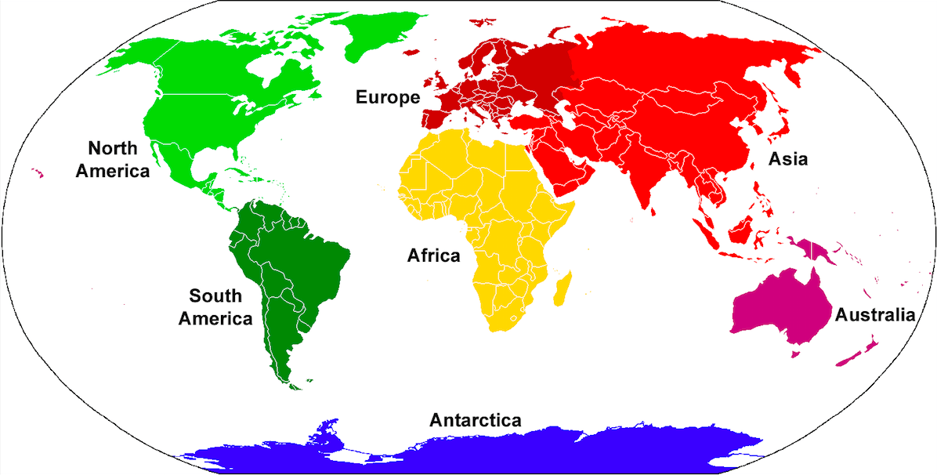
Location Of The Continents

Slide 4
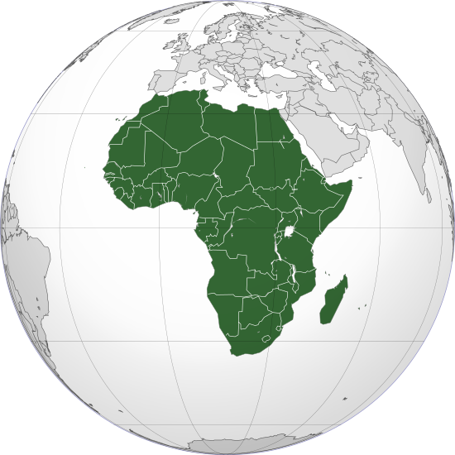
Africa
Africa is the world's second largest and second most-populous continent. At about 30.3 million km² including adjacent islands, it covers 6% of Earth's total surface area and 20% of its total land area

Slide 5
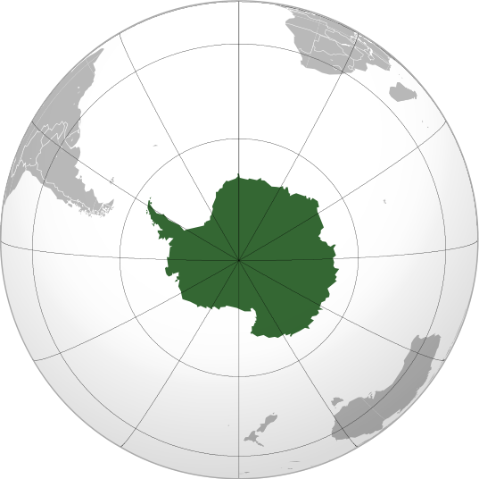
Antarctica
Antarctica, the southernmost continent and site of the South Pole, is a virtually uninhabited, ice-covered landmass.
Area: 14 million km²
Population density: 0.00008/km2 (0.0002/sq mi)
Population: 1,106
Largest cities: Research stations in Antarctica

Slide 6
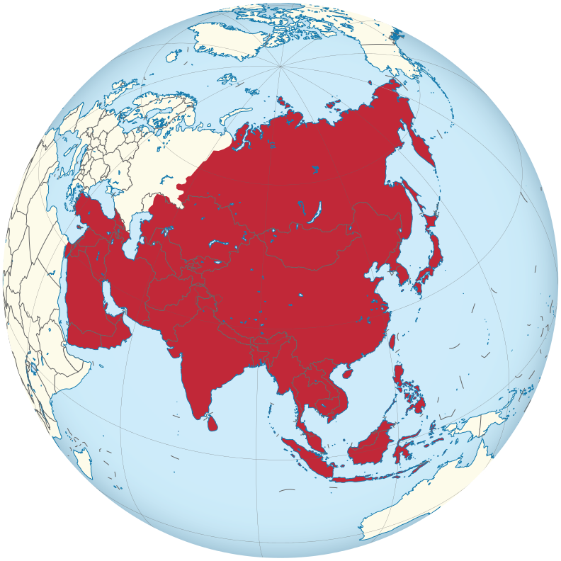
Asia
Asia is Earth's largest and most populous continent, located primarily in the Eastern and Northern Hemispheres.
Area: 44.58 million km²
Population: 4.436 billion (2016)

Slide 7
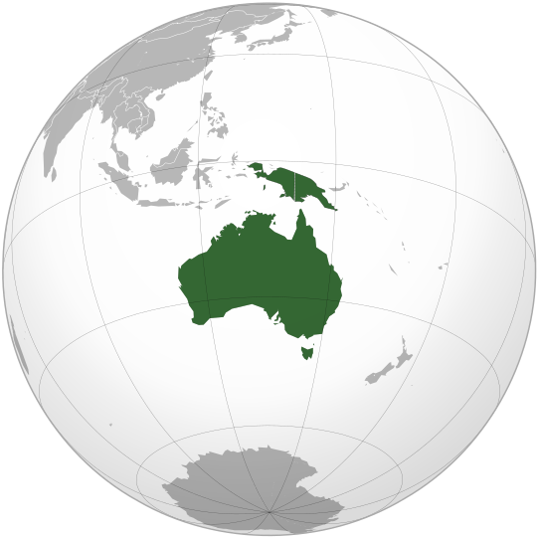
Australia
Australia, sometimes known by the names Sahul, Australinea or Meganesia, to distinguish it from the country of Australia. Area: 8,600,000 km2 (3,300,000 sq mi)

Slide 8
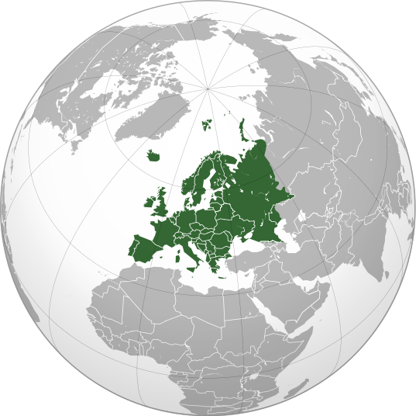
Europe
Europe is a continent located entirely in the Northern Hemisphere and mostly in the Eastern Hemisphere.
Area: 10,180,000 km2 (3,930,000 sq mi). It is bordered by the Arctic Ocean to the north, the Atlantic Ocean to the west, and the Mediterranean Sea to the south.

Slide 9
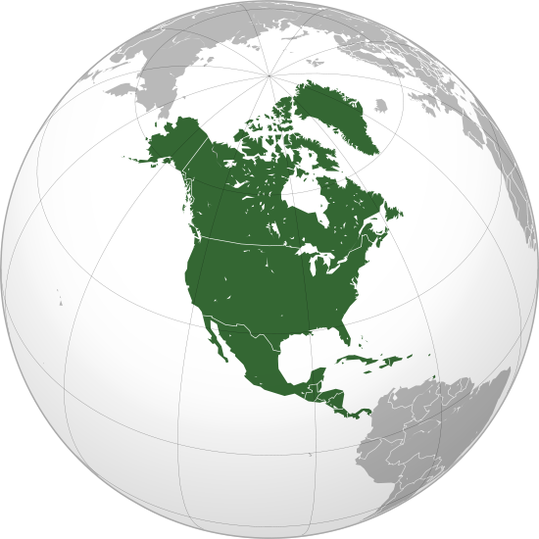
North America
North America is a continent entirely within the Northern Hemisphere and almost all within the Western Hemisphere. North America covers an area of about 24,709,000 square kilometers (9,540,000 square miles). Population: 579,024,000 (2016)

Slide 10
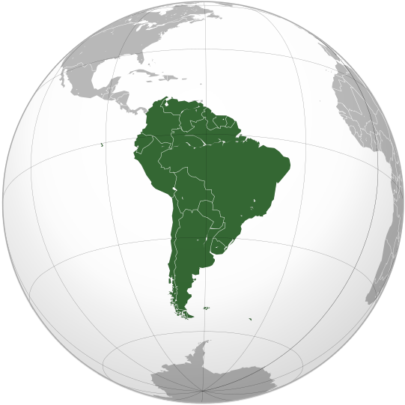
South America
South America is a continent Located in the Western Hemisphere, mostly in the Southern Hemisphere, with a relatively small portion in the Northern Hemisphere. Bordered on the west by the Pacific Ocean and on the north and east by the Atlantic Ocean; N. America and the Caribbean Sea lie to the northwest.

Slide 11
www.ecosystemforkids.com For FREE PowerPoint Lessons
Sources of images:
By Addicted04 - Own workThis vector image includes elements that have been taken or adapted from this: Wallacea.png (by Altaileopard).This vector image includes elements that have been taken or adapted from this: Europe Asia transcontinental.png (by Dbachmann).This vector image includes elements that have been taken or adapted from this: TransAfrica.PNG (by)., CC BY-SA 3.0, https://commons.wikimedia.org/w/index.php?curid=31308289
By Bosonic dressing - Own work, CC BY-SA 3.0, https://commons.wikimedia.org/w/index.php?curid=7072024
By by Luan - Imagem feita a partir de Brazil (orthographic projection).svg., CC BY 3.0, https://commons.wikimedia.org/w/index.php?curid=7197999
By Heraldry - Own work,This vector image was created with Inkscape.The map has been created with the Generic Mapping Tools: http://gmt.soest.hawaii.edu/ using one or more of these public-domain datasets for the relief:ETOPO2 (topography/bathymetry):
By Rob984 - Derived from File:Europe orthographic Caucasus Urals boundary.svg and File:Europe on the globe (red).svg., CC BY-SA 4.0, https://commons.wikimedia.org/w/index.php?curid=40958608
By Australia_(orthographic_projection).svg: Ssolbergjderivative work (colouring in New Guinea, same shade as Australia): Avenue (talk) - Australia_(orthographic_projection).svg, CC BY-SA 3.0, https://commons.wikimedia.org/w/index.php?curid=8727360

